Slide 1
2-Contact Sweeps
4 K, Sample TBG02

Slide 2
Sweep parameters
Sweep from -2V to 2V on the local graphite BG
Dt = 5s
Demodulator TC = Dt/3

Slide 3
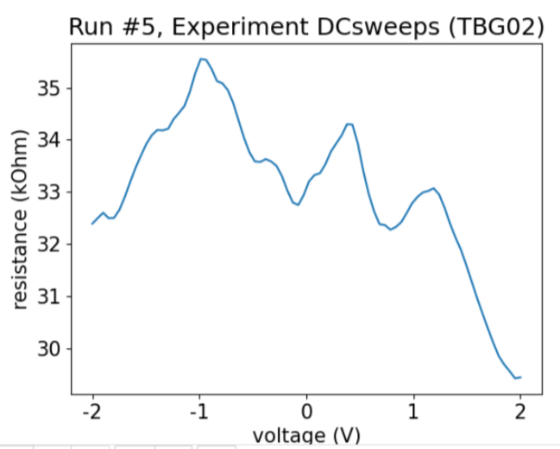
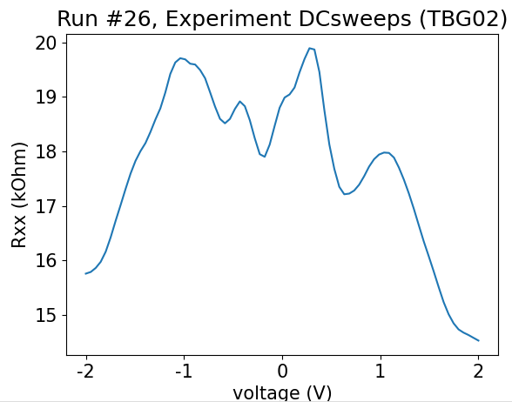
Contacts 24-11
No contact doping
Contact doping : + 30 V

Slide 4
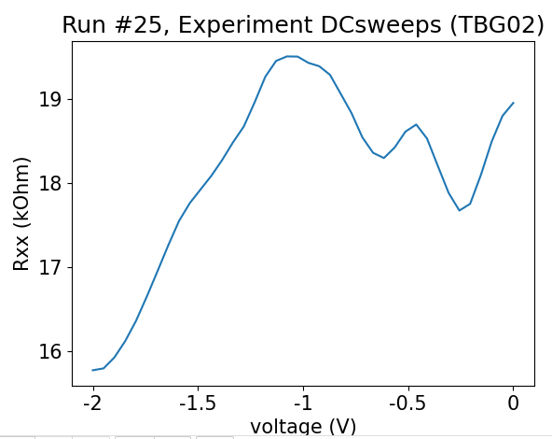
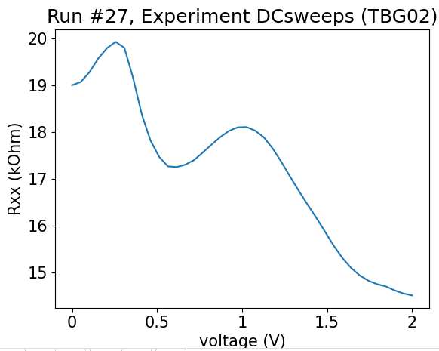
Contacts 24-11
Contact doping : + 30 V
Contact doping : + 30 V

Slide 5
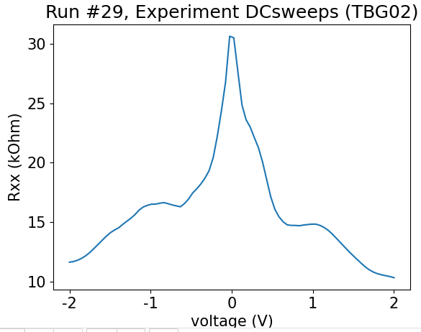
Contacts 24-12
Contact doping : + 30 V

Slide 6
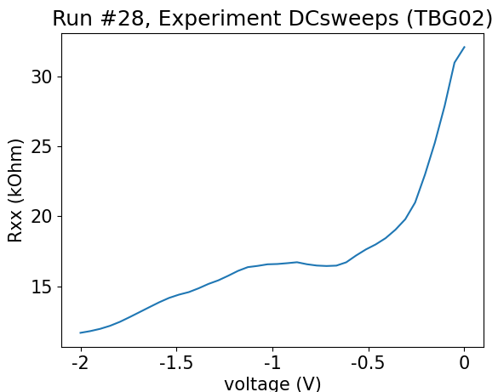
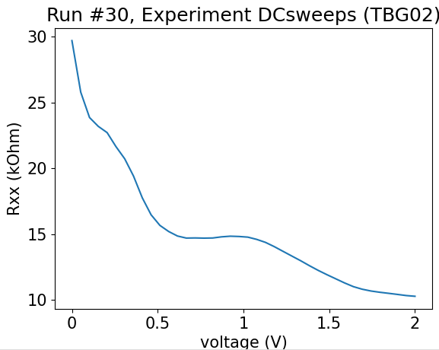
Contacts 24-12
Contact doping : + 30 V
Contact doping : + 30 V

Slide 7
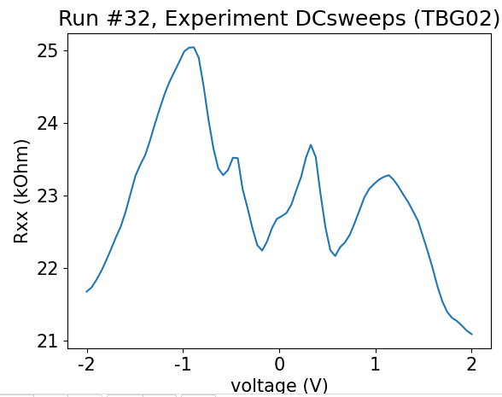
Contacts 24-21
Contact doping : + 30 V

Slide 8
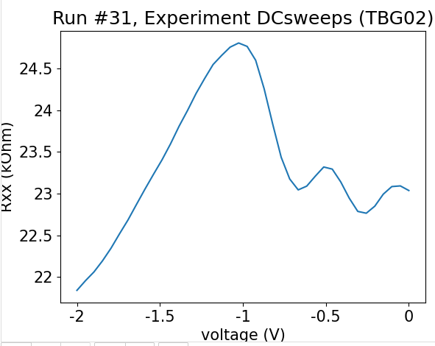
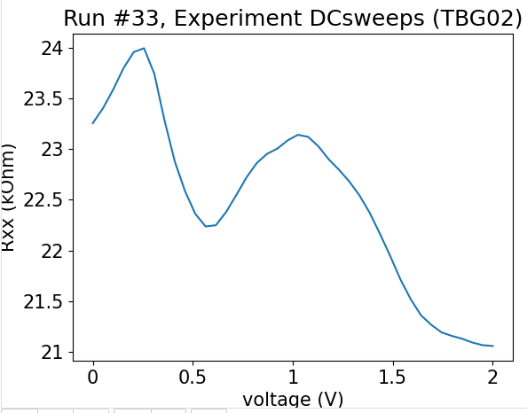
Contacts 24-21
Contact doping : + 30 V
Contact doping : + 30 V

